Slide 1

Ergonomics Semester 2 Week 4

Slide 2
What had been discussed last week
Checkout how is the spine angle estimated

Slide 3
Timeline
Content | Date | Progress
Learning Basics of Deep Learning | Sep 2022 | Done
Installing Alphapose/Openpose/VideoPose3D | Sep-Oct 2022 | Done
Learning Ergonomics Basics | Oct-Nov 2022 | Done
Forming a Framework of Time Continuous Cumulative Fatigue
Preparing for Final Exam | Nov-Dec 2022 | Done
Review the Time Continuous Cumulative Fatigue Framework | Dec 2022 | Done
Trying to Extract Coordinates Using Alphapose/Openpose | Dec 2022
Adding on a Cumulative Fatigue Assessment using Alphapose/Openpose with Python | Jan-Mar 2023
Writing a Technical Report for our Research | Mar 2023

Slide 4
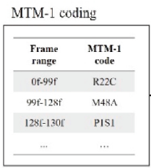
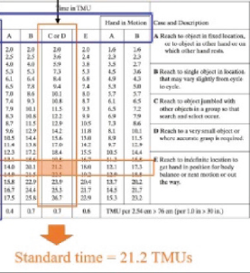
Paper – Automation in Construction
Interpolation
Video Data
3D Visualization
3D Visualization Time Frame
MTM-1 Code
Frame = TMU * 0.036 * fps
Standard Motion Time Frame
REBA & RULA Score
Avg. Risk Score of this motion = Sum of Scores / Standard Time

Slide 5
Paper – Automation in Construction
Predetermined Motion Time System
3D Visualization
Output frame != Input frame
Motion Capture not Accurate
Too Complex to Solve Manually
Automation Algorithm

Slide 6
Conclusion after Reading This Paper
It doesn’t affect our research much
Learn their data pre-processing method (match visualization frame to actual frame) if we have time.
REBA and RULA take repetition into account, but cumulative damage assessment takes future risk into account

Slide 7
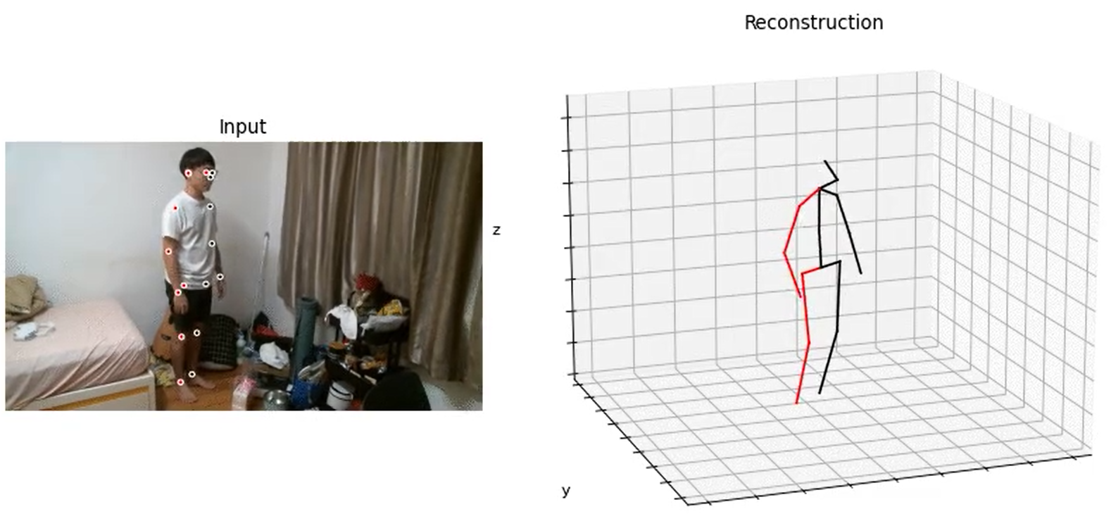
VideoPose3D
Do not be misled by the visualization for the coordinates space
z
x
y

Slide 8
Challenges of This Week
Pose Estimation is a dynamic motion, but we can turn it into statics by d’Alembert Principle. But need to include the fictitious force (inertial force) in the moment equation. Which means we have to approximate the moment of inertia and angular acceleration of human body.

Slide 9
Next Meeting
Design the algorithm to handle moment, if have time can proceed to handle stress
Data Collection
Remember to bring gopro tomorrow
Keep thinking about the difference between cumulative damage and the conventional method like REBA and RULA, the point I mention in this slides is not valid, prof Kim suggests ‘Cumulative Damage allows us to know the endurance limit, so that the we can know how many cycles left of getting fatigue’. But he is not satisfied with this statement.

